Slide 1
ECHOCARDIOGRAPHY …From a Sonographer’s Perspective THE NOTEBOOK 8 Chapter III: Intro to Transthoracic Echocardiogram
Susan King DeWitt, BS, RDCS, RCS

Slide 2
COPYRIGHT INFRINGEMENT IS A SERIOUS CRIME.
Please respect my U.S. Copyright & hard work—do not copy/distribute/edit.
Copyright © 1996, 2002, 2009, 2010, 2011, 2018, 2022. All rights reserved. Library of Congress Catalog Card Numbers: TX0006951179 and TX0008635753.
No part of this publication may be published, shared, edited, voiced over, reproduced, stored in a retrieval system, or transmitted, in any form or by any means, electronic, mechanical, photocopying, recording, or otherwise.
The information in this material is designed to provide education in the field of echocardiography and related topics. It was written, edited, and published by Susan King DeWitt, Author, LLC—a registered cardiac sonographer, not a physician, professional editor, or publishing company. This material does not guarantee a passing grade on the registry exam(s); however, it does discuss most of the test material. References provided do not constitute endorsement of any websites or other sources. Readers should be aware the information and websites listed may change.

Slide 3
ECHO…THE NOTEBOOK 8 & THE WORKBOOK 8
are currently approved by the
Society of Diagnostic Medical Sonography (SDMS)
as a self-instructional activity for
31 CME CREDITS
Please refer to www.echonotebook.com for more details!

Slide 4
III. INTRO TO TRANSTHORACIC ECHO (TTE)
OBJECTIVES
Upon completion of this section, the reader will be able to:
Describe the definition, advantages, indications, and contraindications of the TTE.
Recognize and define basic ultrasound terminology.
Differentiate between the various TTE planes, windows, and views.
Gain knowledge of the three echo modalities, including two-dimensional, M-mode, and Doppler.
Develop a basic understanding of ultrasound instrumentation and tips to improve image quality.

Slide 5
INTRO TO TTE
DEFINITION trans (across/through) + thoracic (chest) echo (ultrasound) + cardio (heart) + gram (recording) TTE noninvasive, real-time ultrasound of heart & attached vessels evaluate anatomy, dimensions, function & blood flow acquired with specialized transducer attached to ultrasound machine | ADVANTAGES minimal staff & equipment noninvasive/pain free portable/bedside provides immediate information relatively inexpensive reliable
POP QUIZ!
What are the three primary echo modalities?

Slide 6
INTRO TO TTE
INDICATIONS cancer therapy CMO CHD disorder of the AO HF IE IHD murmur myocarditis pericardial effusion/tamponade pericarditis/constrictive pericarditis PHV SOB SOE tumor/thrombus/missile VHD | CONTRAINDICATIONS combative patient interstitial air morbidly obese patient refuses

Slide 7
INTRO TO TTE
ULTRASOUND BASICS ultrasound—sound wave with a frequency > 20,000 Hz transducer—handheld device (attached to ultrasound unit) comprised of piezoelectric crystals made of PZT each PZT element transmits & receives ultrasound pulses along a scan line in the shape of a beam → chest; # of PZT elements determines # of scan lines; more scan lines = better resolution each frame shows a complete set of scan lines; near field → focus → far field
POP QUIZ!
Where is the best resolution within the ultrasound beam?

Slide 8
INTRO TO TTE
ULTRASOUND BASICS (continued) matching layer—within PZT crystals, decreases acoustic impedance air—not a good conductor, use a medium ultrasound image—represents the reflection of the sound waves off the structures; dependent on amplitude & depth; pulses leave the transducer → gel → body → collide with structures at varying depths → reflect back to the transducer → unit → gray scale fan-shaped image (sector) most labs → digital storage
POP QUIZ!
What medium do we use in the echo lab?

Slide 9
SONOGRAPHER
acquires images
transfers images to PC
measurements & interpretation
creates preliminary report
CARDIOLOGIST
reads & finalizes report
distributes results to PATIENT
PROTOCOL

Slide 10
INTRO TO TTE
TRANSDUCER FREQUENCY sonographer controls frequency TTE (2 - 12 MHz) adult (2 - 5 MHz) low frequency excellent depth penetration certain cases 5 MHz pediatric (5 - 12 MHz) high frequency excellent resolution neonates 7 MHz or higher
POP QUIZ!
When might a 5 MHz transducer
be used on an adult?

Slide 11
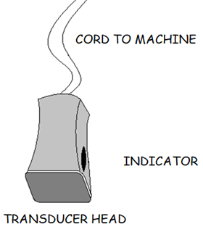
INTRO TO TTE
SCANNING BASICS 4 - 5 windows multiple imaging planes ~ 20+ standardized views transducer orientation via indicator scanning maneuvers conventional vs unconventional views patient physique challenges
POP QUIZ!
List six common
scanning maneuvers.

Slide 12
TILT
SWEEP
ROTATE
SLIDE
ROCK
ANGLE
TTE
POP QUIZ!
Practice these maneuvers,
use a pencil if necessary!
SCANNING MANEUVERS

Slide 13
LEFT PARASTERNAL WINDOW
APICAL WINDOW
SUBCOSTAL WINDOW
SUPRASTERNAL WINDOW
RIGHT PARASTERNAL WINDOW
TTE WINDOWS

Slide 14
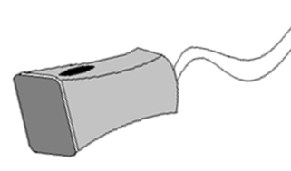
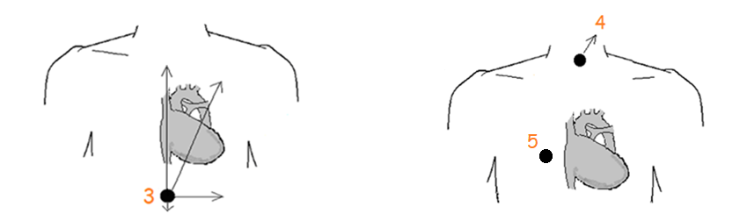
POP QUIZ!
Identify the windows #1 - 5.
POP QUIZ!
What is the black dot?

Slide 15
TRANSDUCER INDICATOR
LEFT PARASTERNAL WINDOW (1) indicator → right shoulder (2) rotate clockwise → left shoulder
POP QUIZ!
Identify the window & views #1 - 2.

Slide 16
TRANSDUCER INDICATOR
APICAL WINDOW (1) indicator → left side (2) rotate counter clockwise → right ear (3) rotate further → right shoulder
POP QUIZ!
Identify the window & views #1 - 3.

Slide 17
TRANSDUCER INDICATOR
SUBCOSTAL WINDOW (1) indicator → left side (2) rotate counter clockwise → left shoulder (3) rotate further → chin (4) angle down into abdomen
POP QUIZ!
Identify the window & views #1 - 4.

Slide 18
TRANSDUCER INDICATOR
SUPRASTERNAL WINDOW (1) indicator → left ear/left shoulder rotate further for SAX variations
POP QUIZ!
Identify the window & view #1.

Slide 19
WINDOW | TRANSDUCER LOCATION | VIEW
LEFT PARASTERNAL | LSB ~ 4th ICS angled posterior | LAX LV, LAX RVIT, LAX RVOT, LAX AO SAX BASE, SAX BASAL/MV, SAX PM/MID, SAX APEX
APICAL | apex ~ PMI angled superior & medial | 4C 5C 2C 3C & 3C RVIT
SUBCOSTAL | inferior to xiphoid process angled superior angled down into abdomen | SUB 4C SUB SAX BASE & LV SUB IVC SUB DAO
SUPRASTERNAL | superior to manubrium angled inferior | SUPRA LAX SUPRA SAX
RIGHT PARASTERNAL | right lateral decubitus position @ right sternal border ~ 4th ICS angled medial

Slide 20
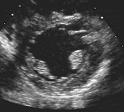
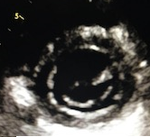
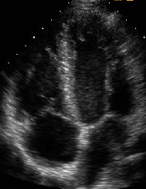
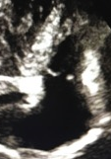
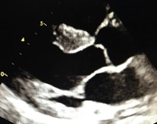
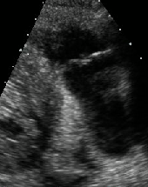
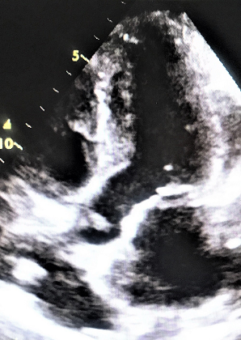
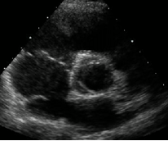
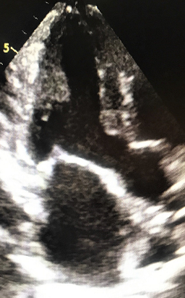
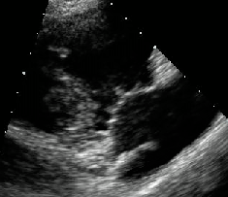
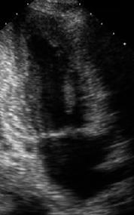
WINDOWS & VIEWS
A
A
B
C
POP QUIZ!
Identify the windows &
views A - C in order
from left to right.

Slide 21
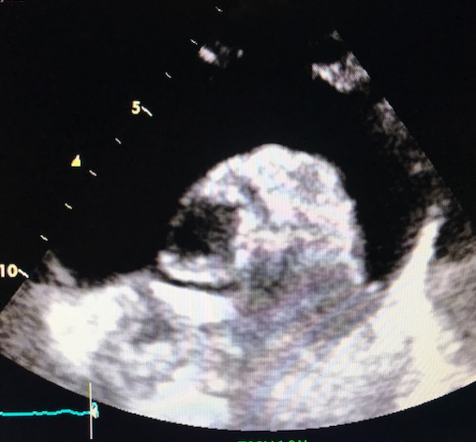
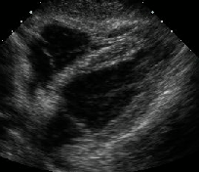
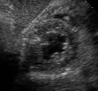
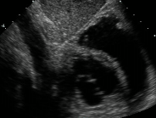
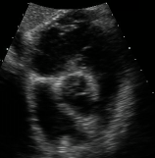
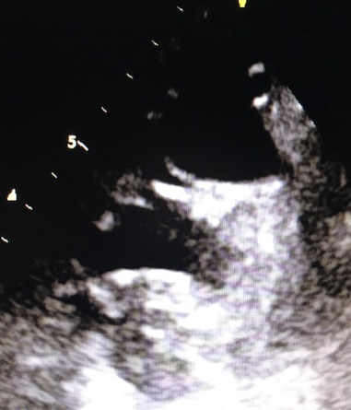
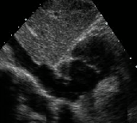
WINDOWS & VIEWS
D
E
POP QUIZ!
Identify the windows & views D - E
in order from left to right.

Slide 22
IMAGING PLANES
POP QUIZ!
Identify the views A - C.

Slide 23
IMAGING PLANES
POP QUIZ!
Identify the views A - C.

Slide 24
IMAGING PLANES

Slide 25
SAX vs APICALS
POP QUIZ!
Identify the views A - C.

Slide 26
2D ECHO
DOPPLER
M-MODE
ECHO MODALITIES

Slide 27
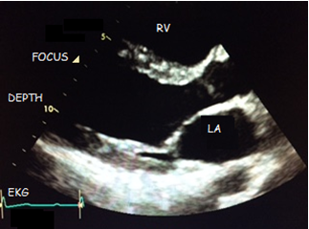
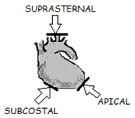
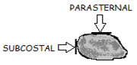
2D ECHO
DEFINITION black & white real-time ultrasound images examine anatomy, function & dimensions relationship to one another
2D IMAGE order of display perpendicular is best!
POP QUIZ!
What is the optimal angle for 2D echo?

Slide 28
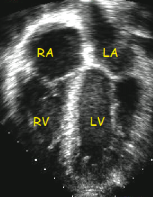
POP QUIZ!
Choose the display used
most frequently in the
adult lab vs pediatric lab.
A B

Slide 29
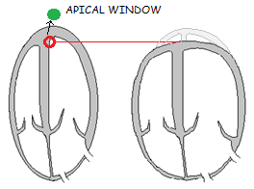
2D ECHO
ON-AXIS vs OFF-AXIS on-axis images transducer location & angulation false positives overlook important findings conventional vs unconventional
POP QUIZ!
Should the apical views be oblong or round?

Slide 30
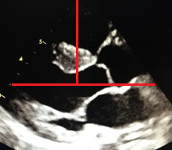
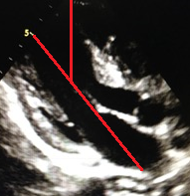
POP QUIZ!
Choose the on-axis image
&
describe how on-axis images
are accomplished.
A B

Slide 31
2D ECHO
INSTRUMENTATION program presets optimize images frame rate depth sector size pre/postprocessing zoom focus overall gain TGC grayscale maps dynamic range transmit frequency harmonic imaging | use the highest frame rate possible to achieve real-time, continuous movement sonographer → increase frame rate & improve temporal resolution decrease depth utilize smallest field of view possible decrease sector width decrease # of focal zones use preprocessing zoom decrease # of scan lines per sector sweep
POP QUIZ!
Which zoom is best?
&
Does harmonic imaging
work best with a high or low
frequency transducer?

Slide 32
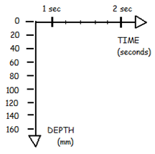
M-MODE ECHO
DEFINITION & INSTRUMENTATION 1D, icepick view → graph superimposed on 2D image sonographer → location & image optimization
TIME-DEPTH GRAPH horizontal plane = time (secs) sweep speeds vertical plane = depth (mm or cm) sonographer → sweep speed & depth

Slide 33
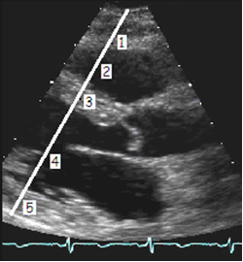
M-MODE & 2D ECHO
POP QUIZ!
Identify the structures #1 - 5.

Slide 34
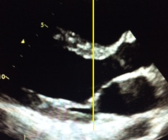
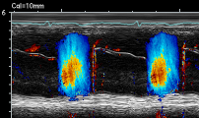
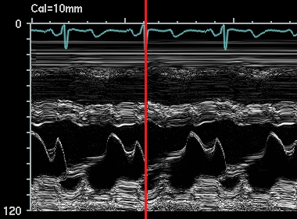
M-MODE
DIMENSIONS ASE recommends 2D dimensions over M-mode dimensions to avoid capturing oblique angles of the walls & chambers. image must be on-axis steerable M-mode
TIMING EVENTS & OTHER USES superior temporal/time resolution most useful → timing events increase/decrease sweep speed compare valve motion to EKG color M-mode IVC diameter & inspiratory collapse hemodynamic compromise analyze AOV cusp motion with LVAD
POP QUIZ!
When does the MV
normally close?
&
Is the example
(above) normal?

Slide 35
DOPPLER ECHO
DEFINITION & DOPPLER ANGLE record velocity & direction of flow spectral Doppler & CFD Doppler interrogation conventional vs unconventional windows & views parallel to blood flow low frequency transducer
POP QUIZ!
Identify the views/valves
with an optimal
Doppler angle.

Slide 36
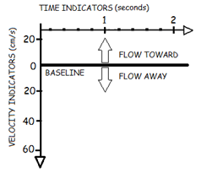
DOPPLER ECHO
SPECTRAL DOPPLER time-velocity graph measures timing, velocity & direction of blood flow horizontal plane = time (secs) vertical plane = velocity (cm/s or m/s) units depend on scale sonographer determines scale depending on velocity of jet machine knows Doppler frequency direction of flow → direction of waveform
POP QUIZ!
Flow traveling toward the transducer
will appear above or below the baseline?

Slide 37
DOPPLER ECHO
INSTRUMENTATION velocity scale & baseline sweep speed decrease sample volume size Overall Doppler gain…what to do? modal velocity wall filter removes clutter
POP QUIZ!
What is the ideal
velocity scale setting?

Slide 38
DOPPLER
Spectral Doppler
CFD
PWD
CWD
Non-Imaging CWD

Slide 39
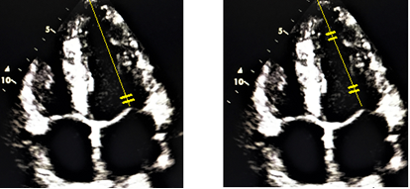
DOPPLER ECHO
PWD user-friendly, originates from imaging transducer superimposed on 2D or color flow image steerable range resolution specific measurements disadvantage → best records low flow velocity < 2 m/s velocity > PWD Nyquist limit → aliasing avoid aliasing → switch to CWD or HPRF Doppler
POP QUIZ!
Identify the HPRF image & its disadvantage.

Slide 40
DOPPLER ECHO
CWD user-friendly, originates from imaging transducer superimposed on 2D or color flow image steerable record a high velocity without aliasing range ambiguity many measurements focus degree of waveform filling relates to amount of turbulence & range of velocities
POP QUIZ!
What is range ambiguity?

Slide 41
POP QUIZ!
Why is flow
above/below
the baseline?

Slide 42
DOPPLER ECHO
NON-IMAGING CWD aka pencil probe, PEDOF blind, stand-alone Doppler probe improves Doppler recordings low frequency small footprint rely on experience & clues position & angle of probe sound of recording timing of waveforms left heart velocities > right heart compare to steerable CWD waveforms Experience!
POP QUIZ!
What is a simple way to
practice non-imaging CWD?
According to the IAC, the non-imaging CWD probe must be utilized in the assessment of aortic stenosis or suspected aortic stenosis.

Slide 43


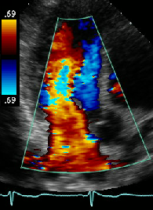
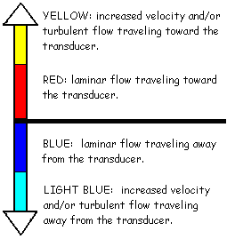
DOPPLER ECHO
CFD & INSTRUMENTATION variation of Doppler converts recorded flow frequencies into different colors examine direction & velocity of blood flow superimposed on 2D or M-mode Doppler interrogation CFD from every view laminar eccentric/turbulent color sector size…start big then decrease to improve resolution & emphasize abnormal flow
A B
POP QUIZ!
Identify the CFD
maps A - B.

Slide 44
DOPPLER ECHO
CFD SETTINGS lab settings should remain consistent to enhance reproducibility CFD appearance BP 2D image quality optimal Doppler angle (0º or 180º) color map laminar vs turbulent flow zoom/decrease sector size adjust color gain red vs blue vs black color flow scale (Nyquist limit) pulsed technique → aliasing | How can the sonographer decrease aliasing? lower transducer frequency increase PRF & Nyquist limit (adjust scale to max)
POP QUIZ!
What is the typical color flow
scale setting & when is it lowered?

Slide 45
POP QUIZ!
Identify the definition # 1 - 9.
TERM | DEFINITION
(1) | converts flow frequencies into different colors
(2) | measure velocity & direction of flow (parallel best)
(3) | black & white, real-time images of heart (perpendicular best)
(4) | 1D, time/depth graph, timing events
(5) | noninvasive, real-time ultrasound of heart
(6) | sound wave with frequency > 20,000 Hz
(7) | steerable & superimposed, range resolution, aliasing
(8) | steerable & superimposed, range ambiguity, high velocity
(9) | improves Doppler recordings due to low frequency & small footprint
Notes:
ECHO…THE NOTEBOOK 6.5
CH 3, PG 70
ANSWER: (1) color flow Doppler; (2) spectral DOPPLER; (3) 2D ECHO;
(4) m-mode; (5) ECHO; (6) ultrasound; (7) PW Doppler; (8) CW Doppler;
(9) NONIMAGING CW DopplEr

